Slide 1
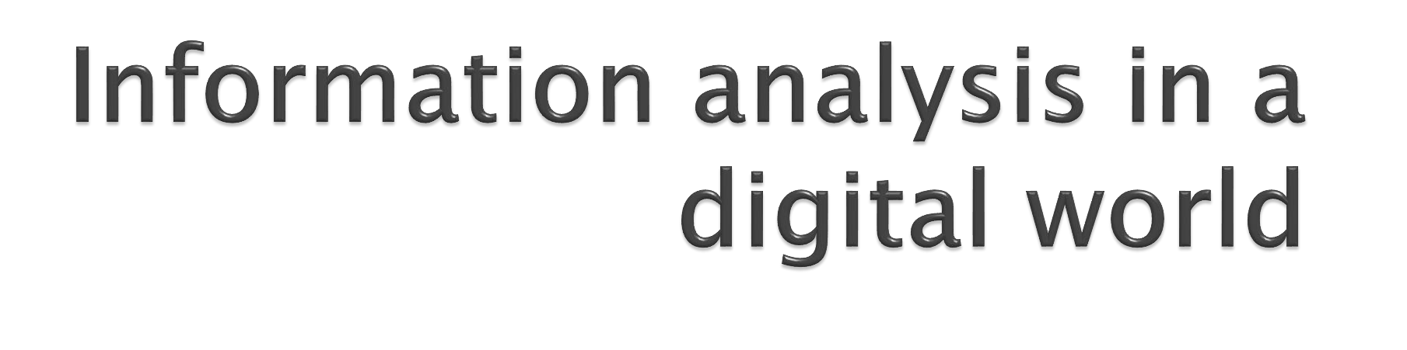
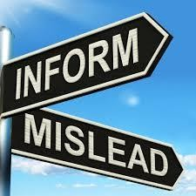


Slide 2
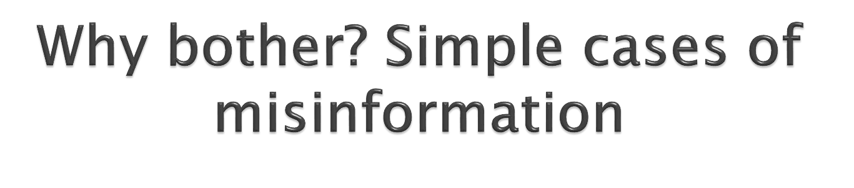
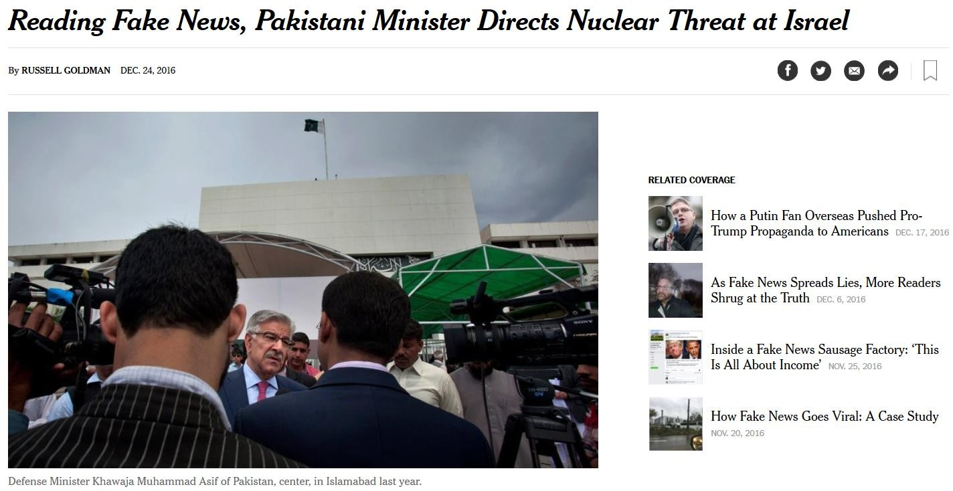
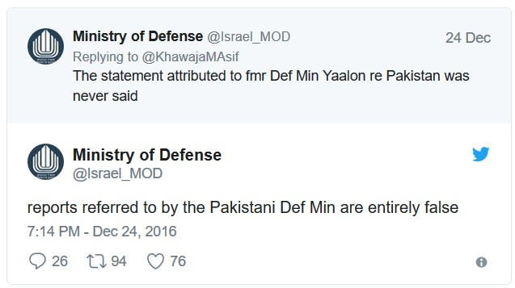

Slide 3

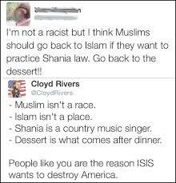

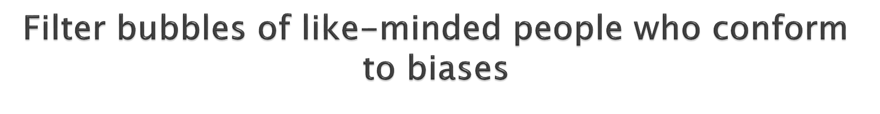

Slide 4
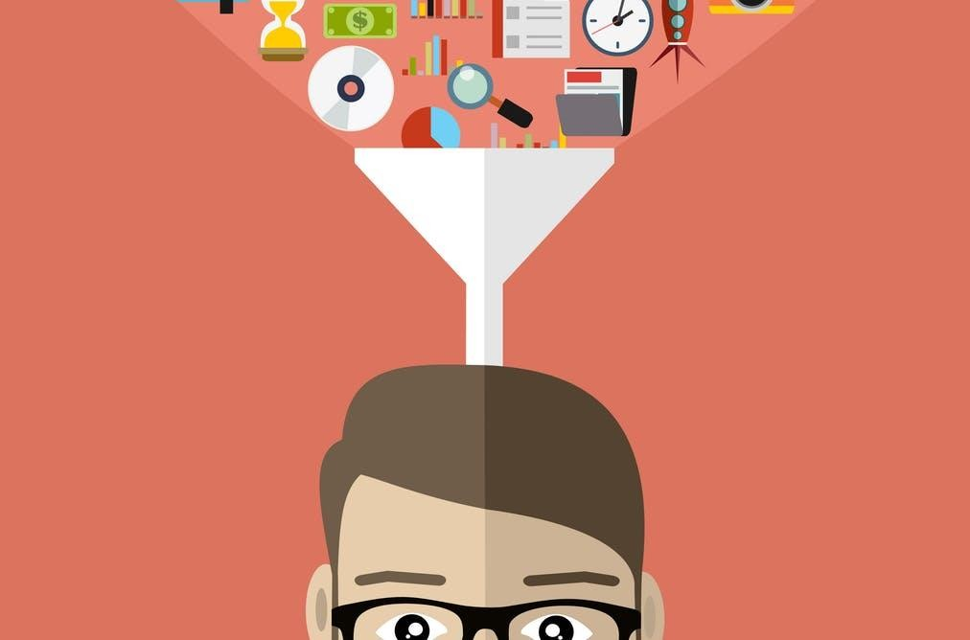


Slide 5
Critical thinking: question everything
Check sources:
Peer-reviewed scientific journals > conferences > magazines and
newspapers > broadcast news
Go through ‘about us’, lookup for author, his organization page and publisher’s homepage
Typical sausage factories’ signs:
Click-bait (13 reasons you should read this page…)
Fake email accounts, unknown authors
Supporting evidence:
Bigger the claim, more the sources to backup
Check each detail at multiple levels

Slide 6
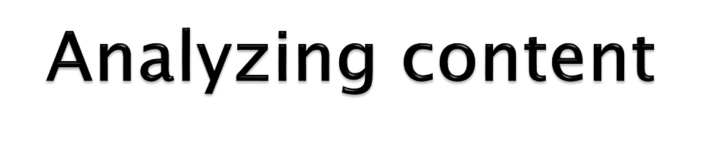
Content analysis
Facts vs opinion
First thing to look for: data, studies, surveys, polls, scientific proofs
“Without data, it’s my word vs yours”
Detail in content, all Ws,
Conflict of interest
Rebuttal (accusation), criticism and context

Slide 7

Some good sources of information
HBR, Vox, Economist, Guardian
Washington Post, NYT, BBC, CNN
Print journalism has peer-review, TV doesn’t
A Fox news study 2 years ago showed that:
More TV doesn’t make you more informed, it might make you more
uninformed

Slide 8

More on how to spot fake news
https://www.factcheck.org/2016/11/how-to-spot-fake-news/

Slide 9
How to Spot Fake News
Consider the source
Read beyond the headline
Check the author
What’s the support
Check the date
Is this some kind of joke ?
Check your biases
Consult the experts

Slide 10
Fallacy
A fallacy is the use of invalid or otherwise faulty reasoning, or "wrong moves" in the construction of an argument
A fallacious argument may be deceptive by appearing to be better than it really is

Slide 11
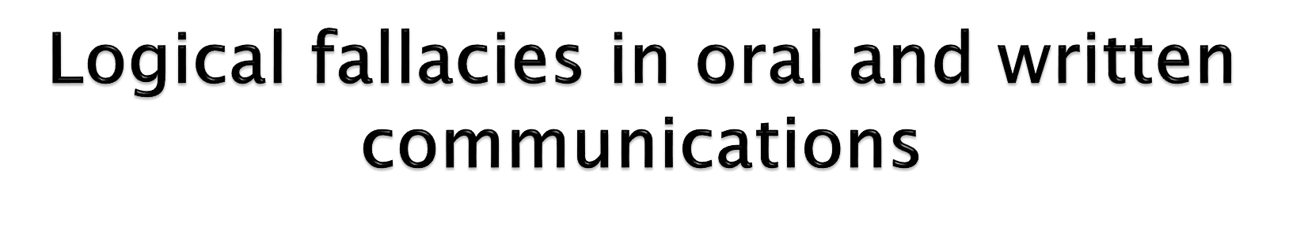
“If you were a true American you would support the rights of people to choose whatever vehicle they want”
“I am the teacher. You are not qualified to talk about this topic”
“Even though it's only the first day, I can tell this is going to be a boring course”

Slide 12

You said that because an authority thinks something, it must therefore be true.
Not able to defend his position that evolution 'isn't true' Bob says that he knows a scientist who also questions evolution.
‘You will tell me about Islam?‘
“This must be true because teacher/Stephan Hawking said so”

Slide 13
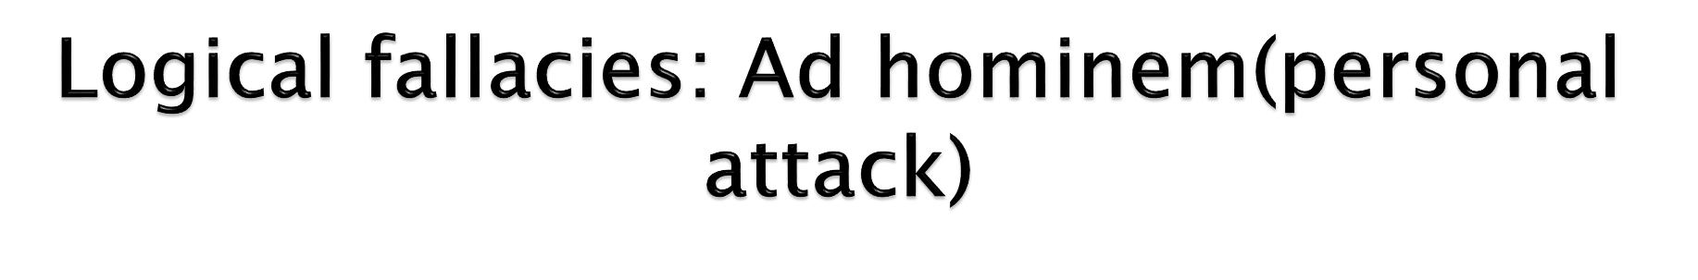
You attacked your opponent's character or personal traits in an attempt to undermine their argument.
‘Green Peace's strategies aren't effective because they are all dirty, lazy hippies”
“Indians are wrong about history because they worship cows”
“Political party A is better than B, because Bs leaders are corrupt”

Slide 14

You used a personal experience or an isolated example instead of a sound argument or compelling evidence.
“I know two blondes, they are stupid so blondes are always stupid”
“Lahore is a better city than X because I went there once and I saw many roads”
“I went to KPK, met 10 people and it has changed”

Slide 15

You attempted to manipulate an emotional response in place of a valid or compelling argument.
“I want to make a LUMS like university for poor. Think about all the poor”
“You must not say it because it destroys image of the country. Don’t you love your country?”
“My project should be graded higher because I couldn’t work because my mother has stage 3 cancer”

Slide 16

“Even though it's only the first day, I can tell this is going to be a boring course.”
“Politicians are all corrupt”

Slide 17
Strawman
You misrepresented someone's argument to make it easier to attack.
Example: After Will said that we should put more money into health and education, Warren responded by saying that he was surprised that Will hates our country so much that he wants to leave it defenseless by cutting military spending.

Slide 18
tu quoque
You avoided having to engage with criticism by turning it back on the accuser - you answered criticism with criticism.
Example: Nicole identified that Hannah had committed a logical fallacy, but instead of addressing the substance of her claim, Hannah accused Nicole of committing a fallacy earlier on in the conversation.

Slide 19
loaded question
You asked a question that had a presumption built into it so that it couldn't be answered without appearing guilty.
whether someone was still having problems with her drug habit?.

Slide 20
ambiguity
You used a double meaning or ambiguity of language to mislead or misrepresent the truth.
Example: When the judge asked the defendant why he hadn't paid his parking fines, he said that he shouldn't have to pay them because the sign said 'Fine for parking here' and so he naturally presumed that it would be fine to park there.

Slide 21
genetic
You judged something as either good or bad on the basis of where it comes from, or from whom it came.
Example: Accused on the 6 o'clock news of corruption and taking bribes, the senator said that we should all be very wary of the things we hear in the media, because we all know how very unreliable the media can be.

Slide 22
black-or-white
You presented two alternative states as the only possibilities, when in fact more possibilities exist.
Example: while rallying support for his plan to fundamentally undermine citizens' rights, the Supreme Leader told the people they were either on his side, or they were on the side of the enemy.

Slide 23

Complete list of logical fallacies
https://yourlogicalfallacyis.com/

